Slide 1

Department of Electronics and
Communication
Predict the possible health issues in pregnant women
Aaron Lawrence Lasrado - 4SO21EC002
Muhammad Shakeel – 4SO21EC061
Mahammad Danish – 4SO21EC052
Amish Harshal – 4SO21EC010
Adithya achar – 4SO21EC006

Slide 2

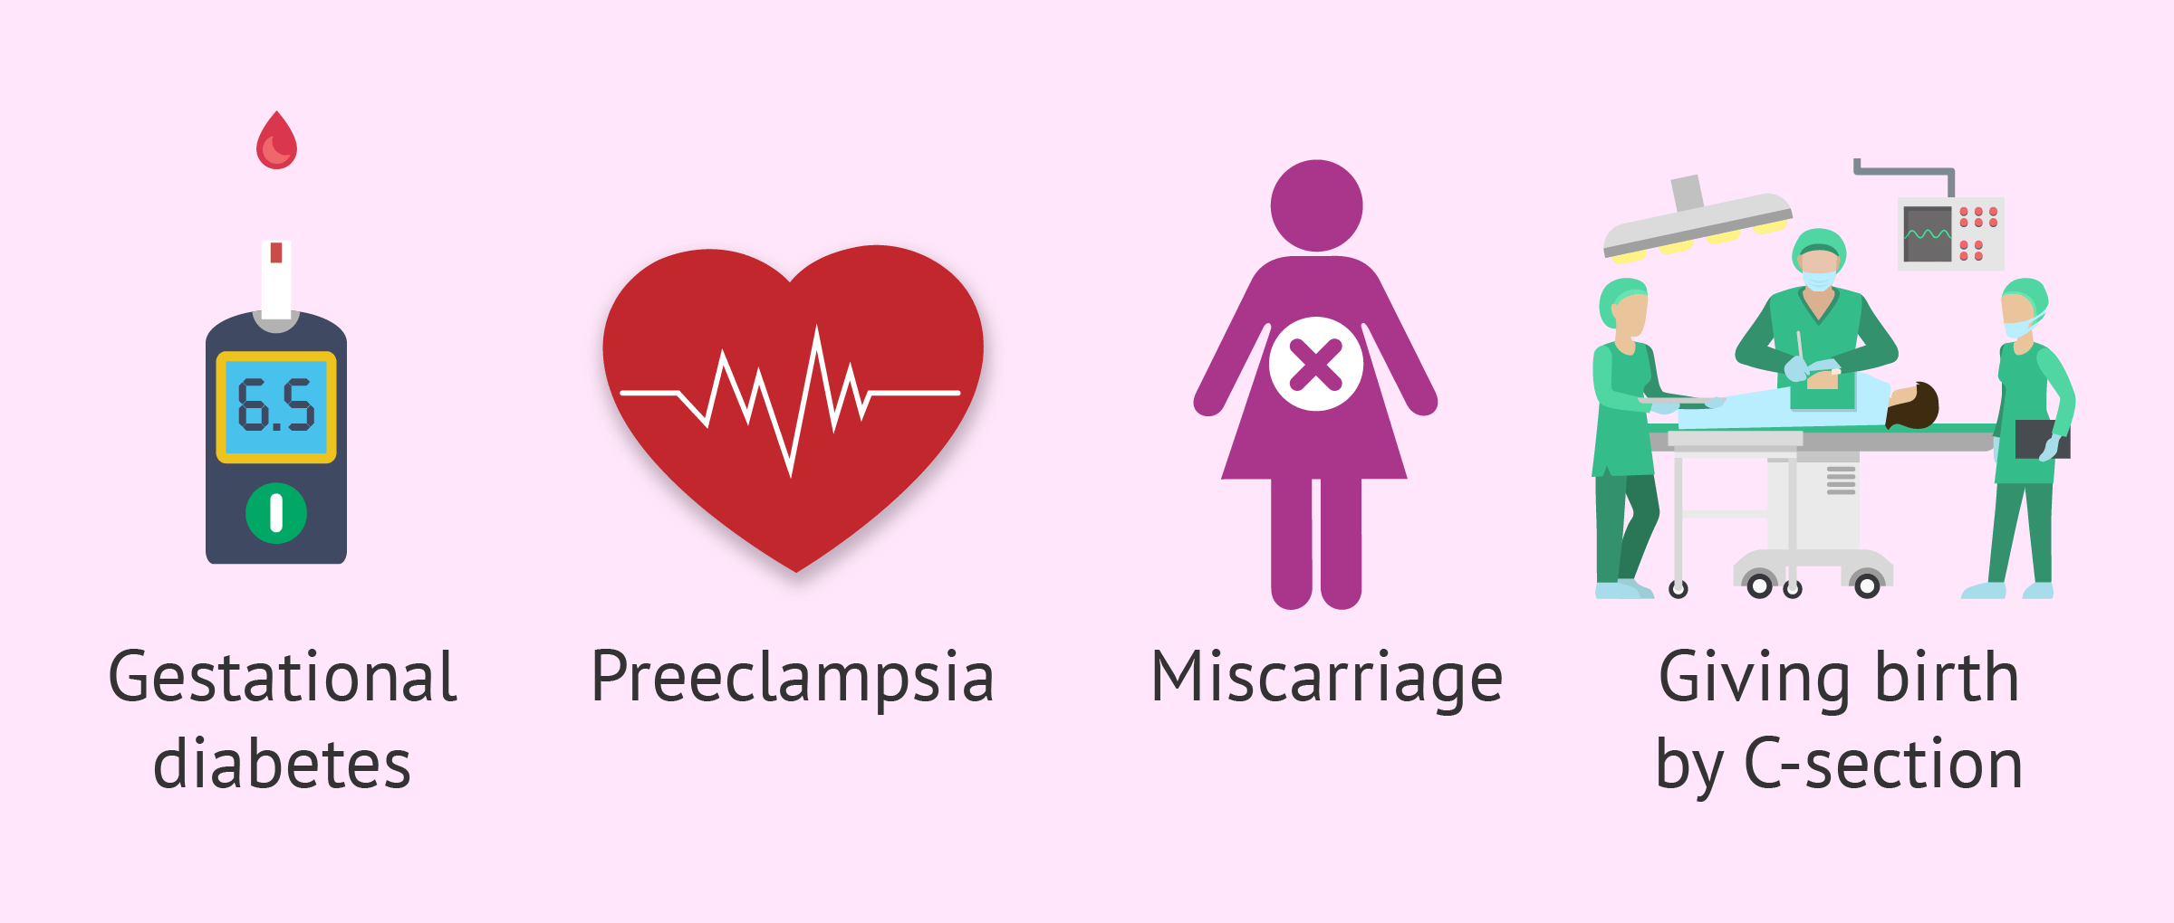
INTRODUCTION
According to WHO, 810 women die every day in this world due to childbirth and pregnancy-related complications, while the majority (94%) of all maternal deaths occur in low and lower-middle-income countries . Due to the recent advancement in technology, the rate of maternal deaths is reducing , yet is a challenging task to ensure the safety of both mother and child during pregnancy. In such a scenario, the pregnancy-related risks can be reduced by forecasting the complications and by taking preventive measures. Thus, the use of predictive modeling became emergent to save the lives of millions of mothers and infants.
The common maternal complications responsible for the majority of maternal deaths are gestational diabetes, severe bleeding, infection, preeclampsia, eclampsia, prolonged labor, preterm labor, and unsafe abortion .

Slide 3
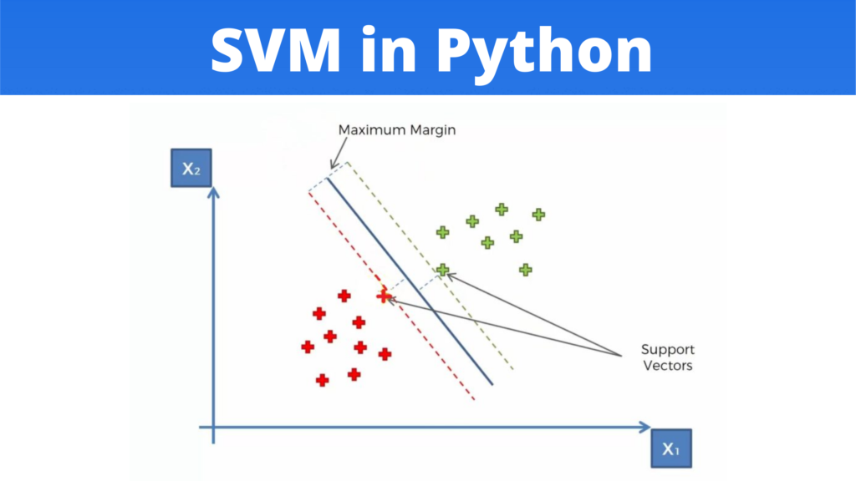
Algorithm
Support Vector Regression (SVR):
A Support Vector Regression (SVR) is a type of Support Vector Machine , and is a type of supervised learning algorithm that analyzes data for regression analysis.
In 1996, this version of SVM for regression was proposed by Christopher J. C. Burges, Vladimir N. Vapnik , Harris Drucker, Alexander J. Smola and Linda Kaufman. The model produced by SVR depends only on a subset of the training data, because the cost function for building the model ignores any training data close to the model prediction.

Slide 4
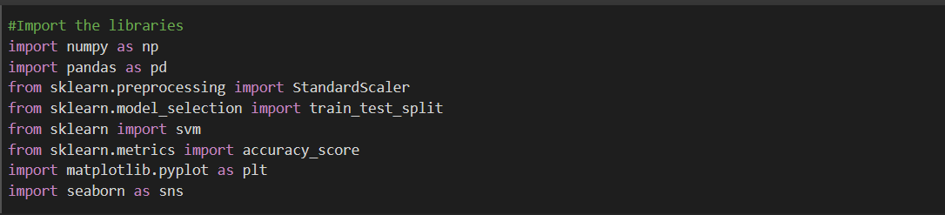
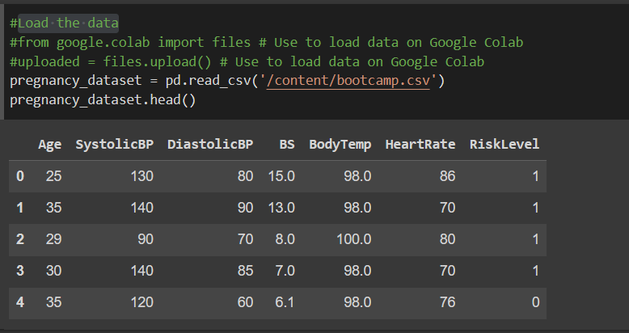
Implementation of program based on Algorithm
Imported the packages /libraries to make it easier to write the program.
Load the dataset.

Slide 5
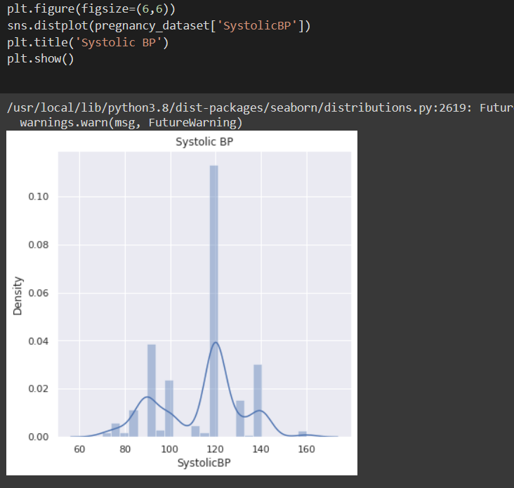
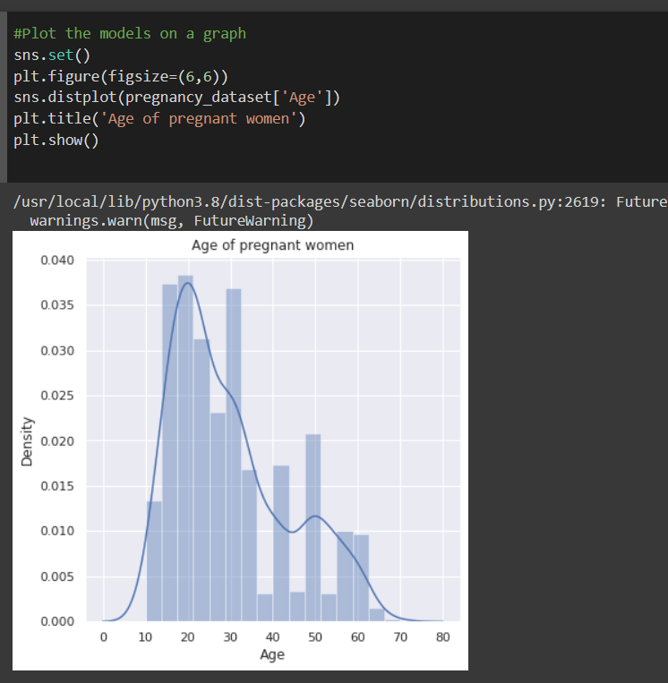
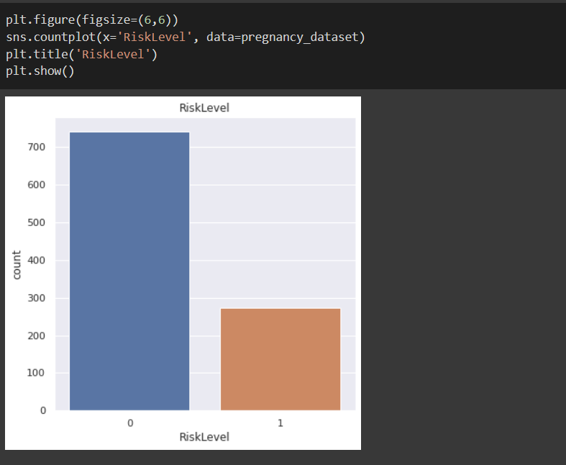
Plotted the models on a graph to see which has the best fit and returned the prediction

Slide 6
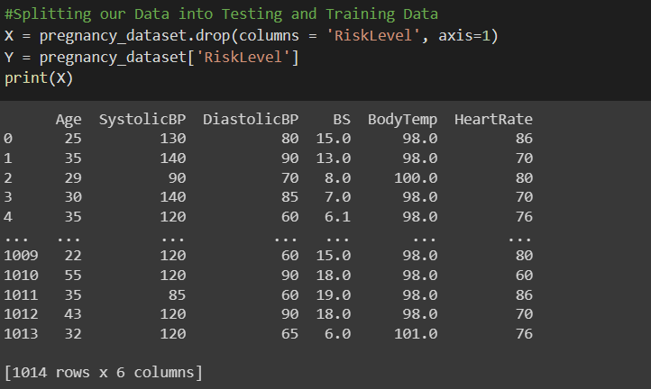
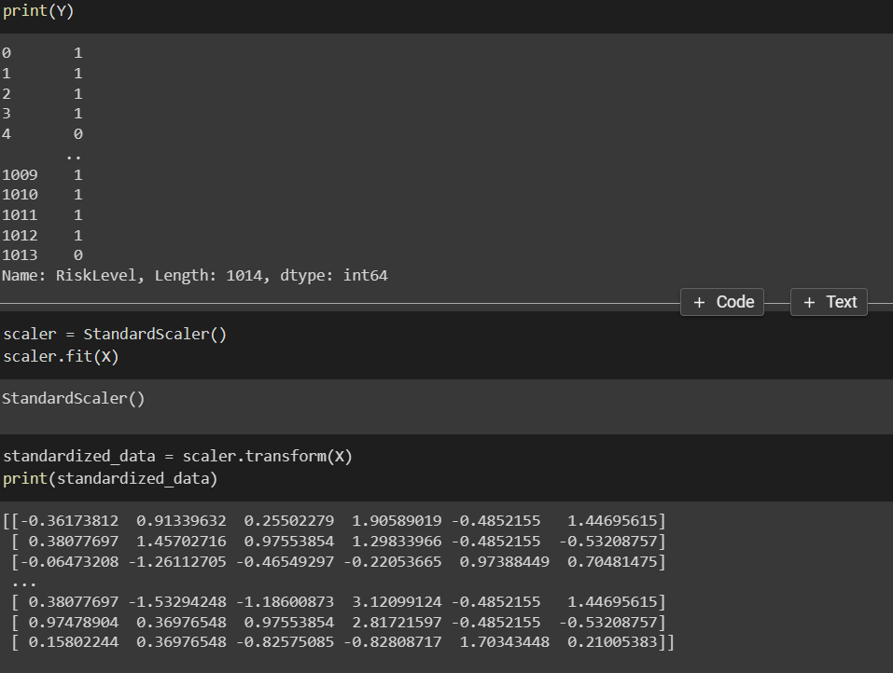
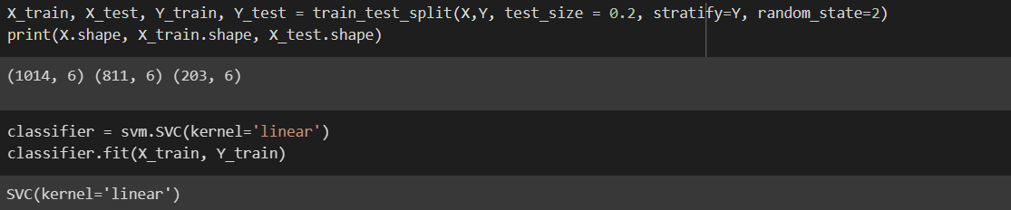
Splitting our Data into Testing and Training Data

Slide 7
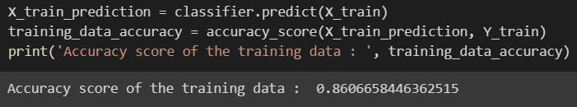
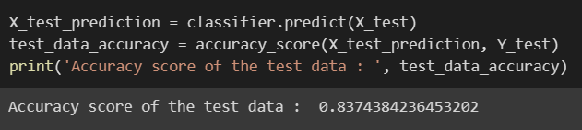
Building and training our model
Building and testing our model
We can now use the model to make predictions of the data. We can do this by using the .predict() method and passing in our testing features.

Slide 8
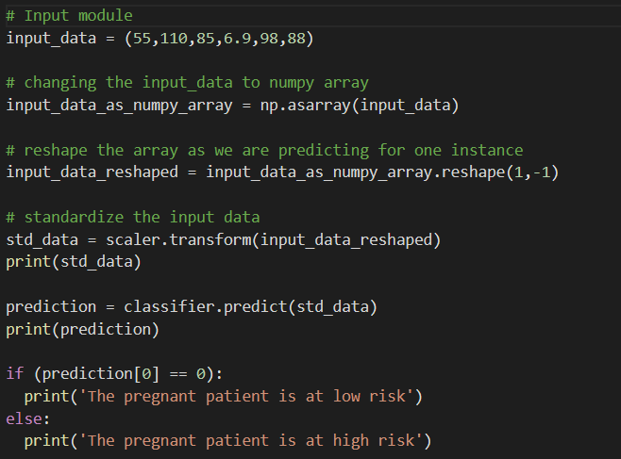
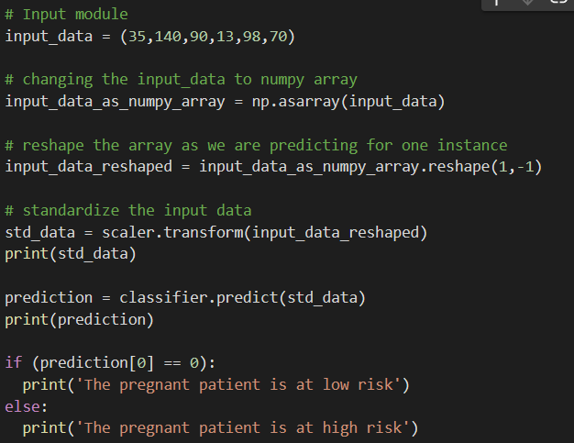

Input module for the prediction model
Output

Slide 9
THANK YOU
Reference: https://www.youtube.com/watch?v=xUE7SjVx9bQ&t=722s
https://colab.research.google.com/drive/1oxnhMTlomJ4HVhPuowpPFyMt1mwuOuQo?usp=sharing
https://datagy.io/python-support-vector-machines/
https://archive.ics.uci.edu/ml/machine-learning-databases/00639/Maternal%20Health%20Risk%20Data%20Set.csv

